Slide 1
Final Project:
Music Generation from Sign Language
Group 1
Teammate:
111550203Tymofii Voitekh
111514013Kaiwi Wang
109612029郭子維
109951140蘇子恩

Slide 2
Preparation: Finding Topic
Find any topic which is not repeated and is creative
We wanted to do something meaningful and useful, yet manageable
Challenges:
Limited Data
Limited Resources
Huge Training Time

Slide 3
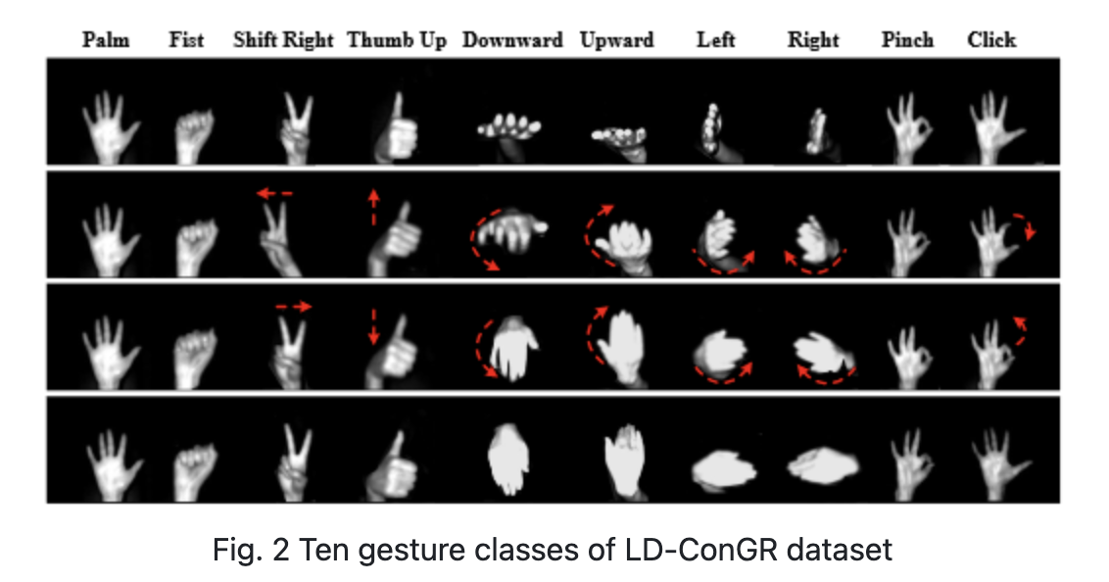
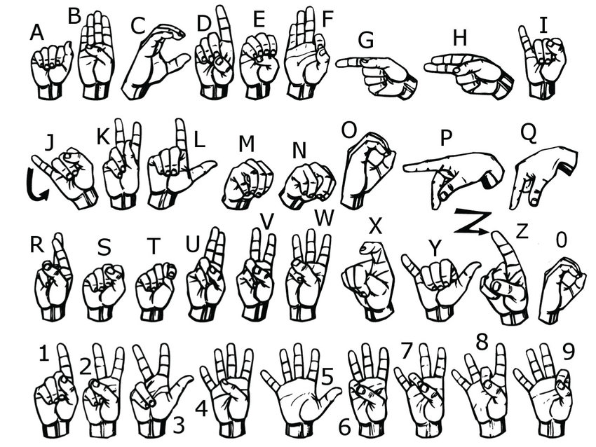
Preparation: Developing an Idea
After thorough exploration, we decided to stick with something related to gesture recognition and interpretation.
Our initial idea did not change much, other than being extended to the entire sign language alphabet, rather than only a very limited number of gestures.
With our final approach we were able to capture more emotions and generate more suitable musical patterns

Slide 4
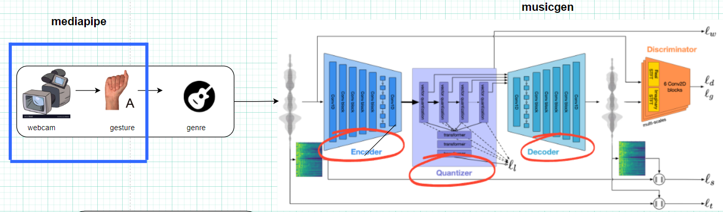
Introduction
We want to design a program to takes in gestures and turn it into music. To do this, we must convert the hand gestures to musical genres and use them as prompts for music generation. We utilize mediapipes deep learning architecture . Then, we map the gestures to genres. Finally, we can see what the gestures represent in the form of music.

Slide 5
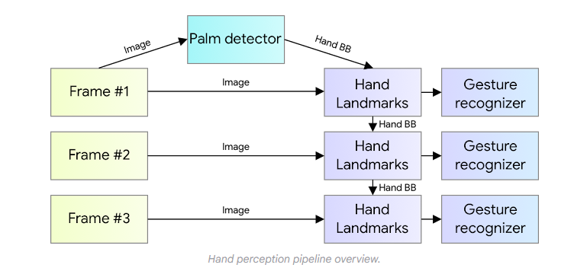
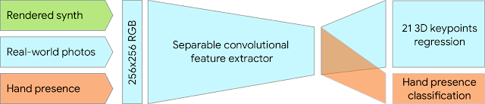
Hand gesture capturing
BlazePalm Model: Detecting palms by having a region of interset(ROI), as opposed to the whole hand, simplifies the problem because palms are rigid and easier to detect.
Square Bounding Boxes: Palms are modeled with square bounding boxes as ROI, reducing the complexity.

Slide 6
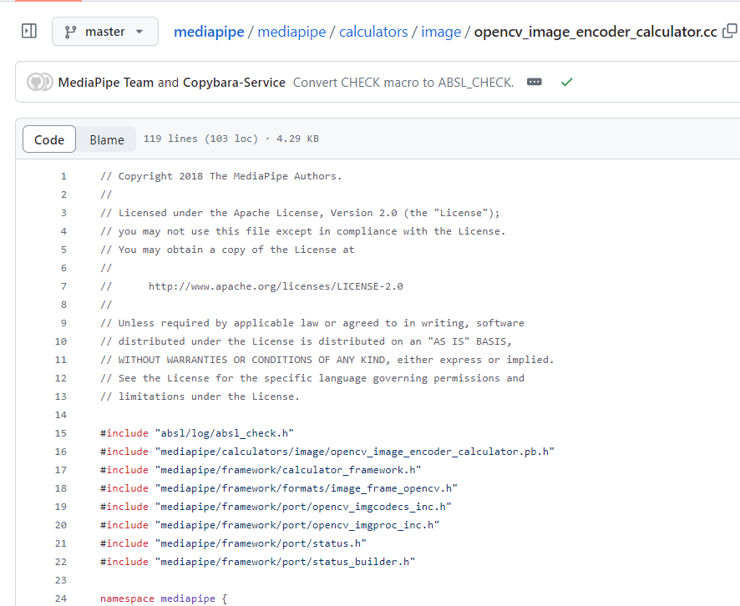
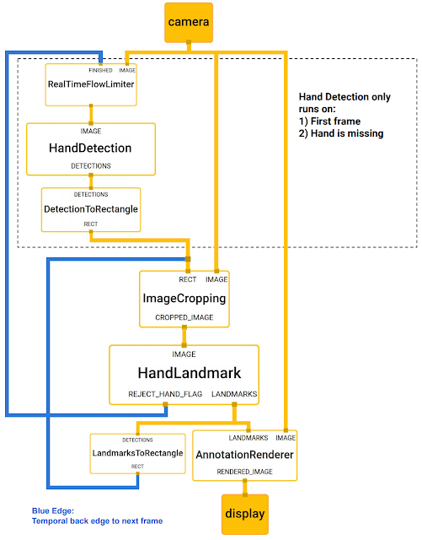
Encoder-Decoder Architecture: The palm detection model uses an encoder-decoder architecture for feature extraction, which helps in understanding the context of the scene even for small objects like palms.

Slide 7
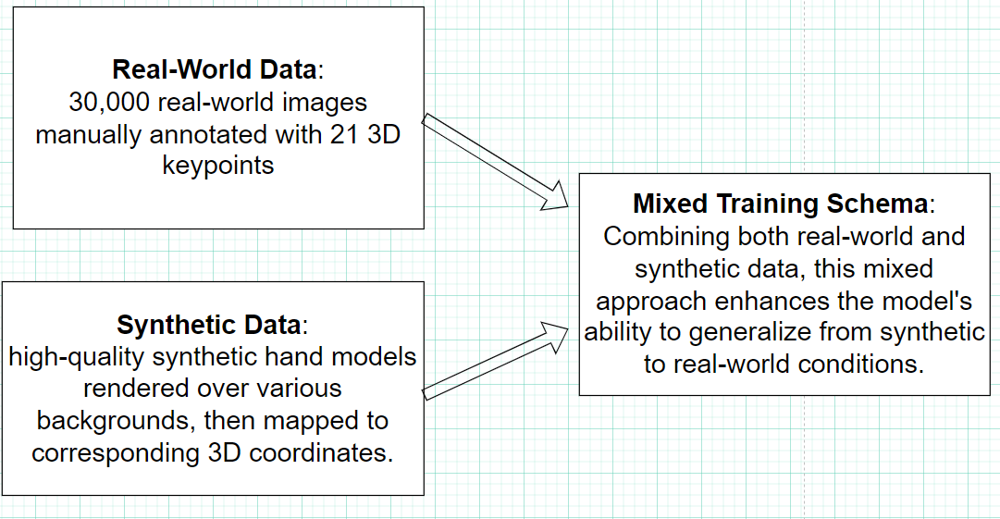
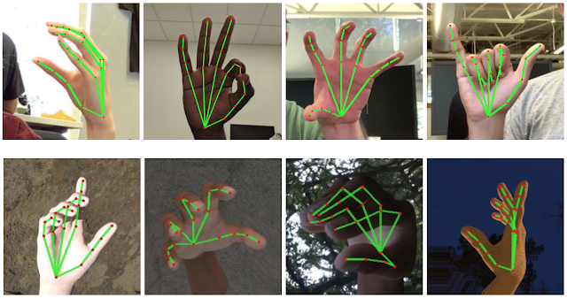
Dataset
MediaPipe's hand tracking model is trained on a combination of real-world and synthetic datasets to ensure robust performance.

Slide 8
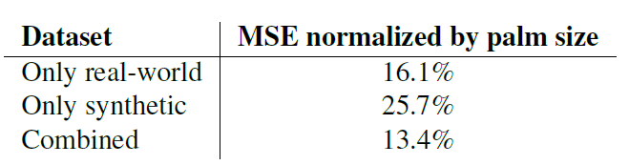
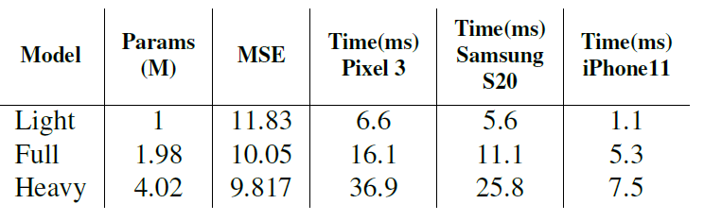
Extra: mobile device application

Slide 9
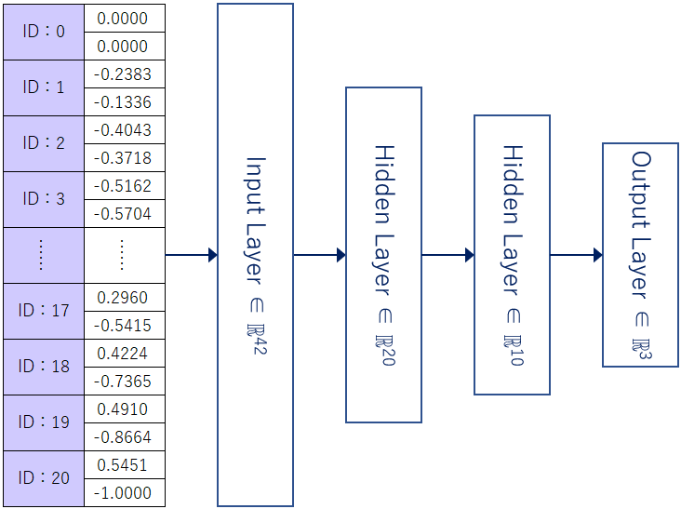
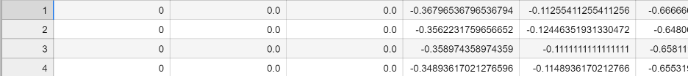
CNN for hand sign recognition
Dataset:
keypoint.csv:
First Column: Class ID (A to Z and 0 to 9) - This represents the label or category of the hand gesture.
Second and Subsequent Columns: Keypoint coordinates - These are the x, y coordinates of the detected 21 key points on the hand.

Slide 10
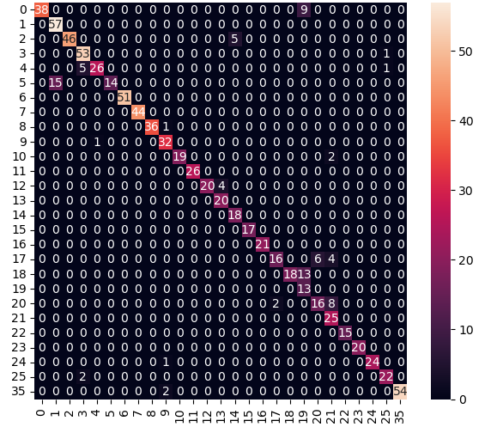
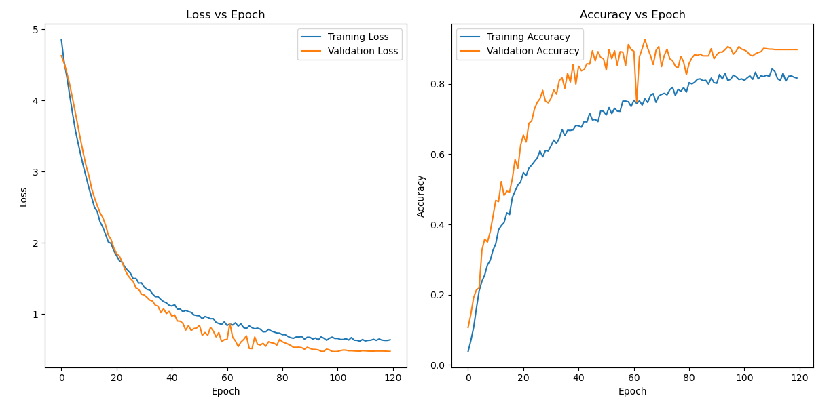
Results:

Slide 11
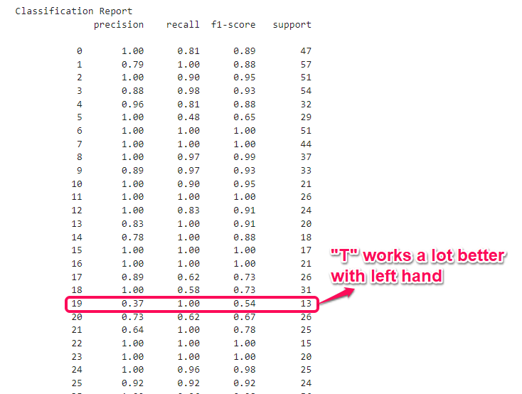
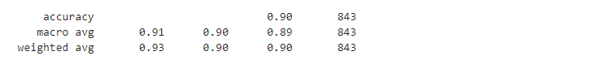

Slide 12
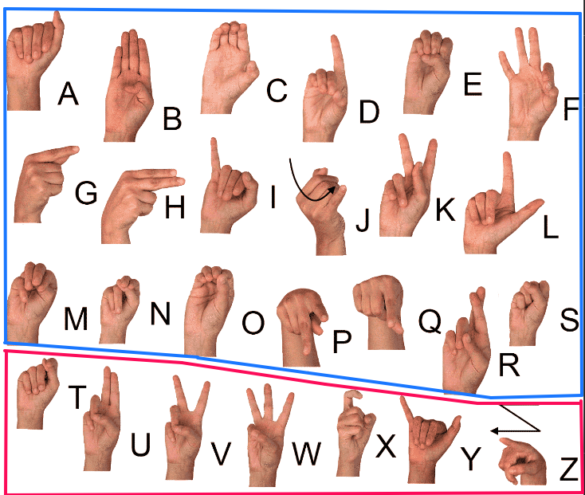
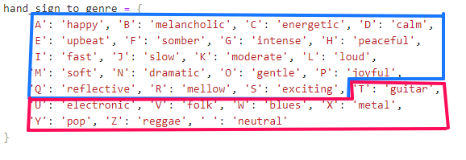
ASL mapping to genre, instruments feeding to musicgen:

Slide 13
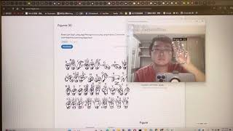
Gesture recognition demo:

Slide 14
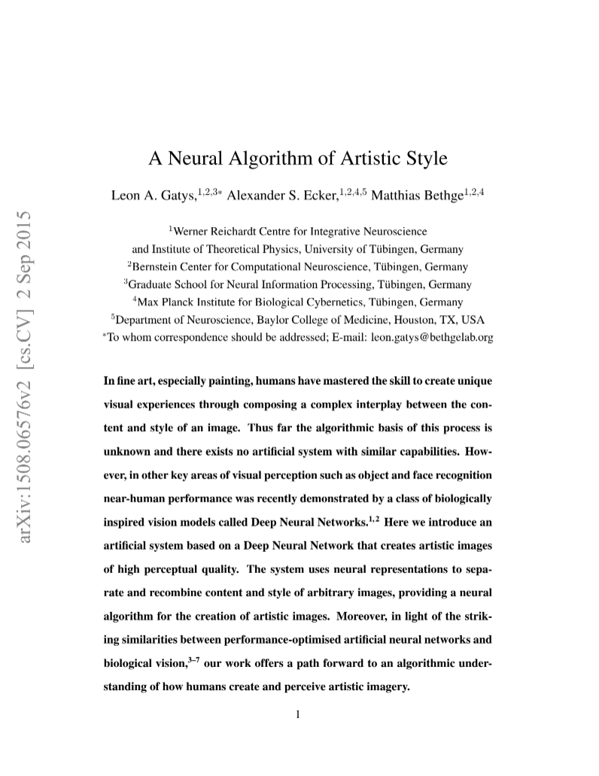
Paper Reading- “A Neural Algorithm of Artistic Style”
To let the music sound like the masterpiece, we have to try something that can take out the Artistic Style out of the masterpiece. We read the paper “A Neural Algorithm of Artistic Style”presents a groundbreaking approach in the field of computer vision and artificial intelligence.
*The Paper can be find in this address: https://arxiv.org/abs/1508.06576

Slide 15
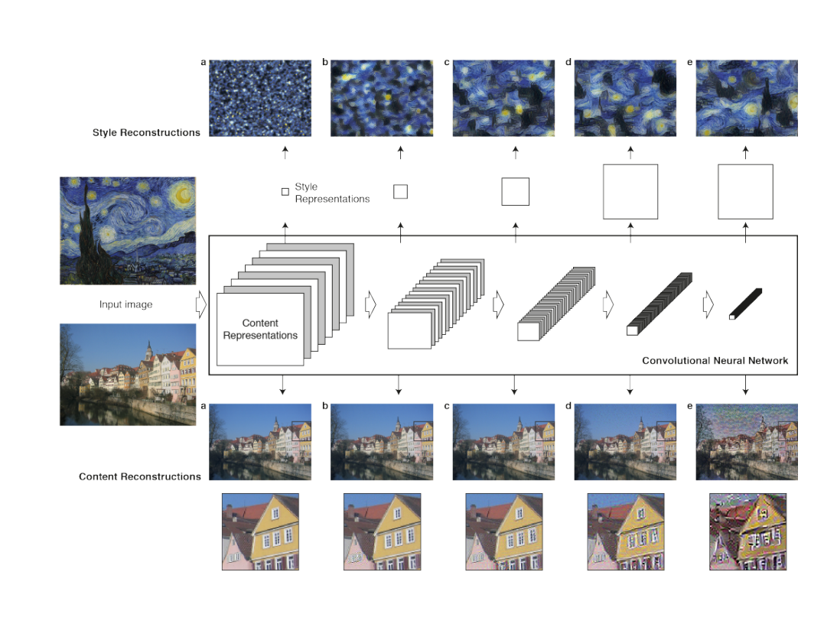
Paper Reading- “A Neural Algorithm of Artistic Style”
It introduces a system based on Deep Neural Networks (DNNs), particularly Convolutional Neural Networks (CNNs), that can create artistic images by separating and recombining the content and style of different images.
*An example use of DNNs that show in the paper

Slide 16
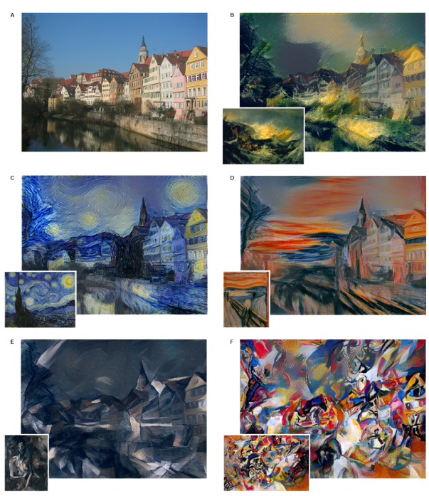
Paper Reading- “A Neural Algorithm of Artistic Style”
This system uses neural representations to understand and manipulate the style and content independently, allowing the generation of new images that blend the style of one image (like a painting) with the content of another (like a photograph).
But this time we are using the Artistic Style to change the melody.

Slide 17
What we find out?
The central theme of our project is the fusion of machine learning and music processing to explore style transfer across art compositions. The project focuses on transforming MDCT (Modified Discrete Cosine Transform) spectrograms, a time-frequency representation of audio signals.
MDCT is a transformation method used in audio signal processing. It is a variant of the Discrete Cosine Transform (DCT) and is commonly applied in music and speech compression, as well as in the representation and analysis of audio signals. The main feature of MDCT is to divide the signal into time segments and apply DCT to each of these segments.

Slide 18
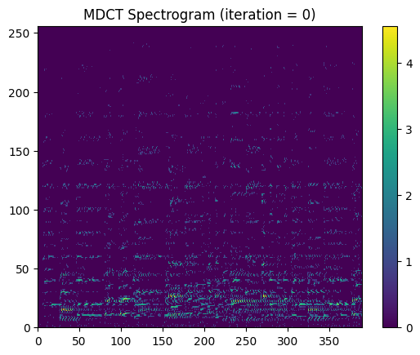
MDCT Spectrogram
The vertical axis represents frequency, and the horizontal one represents time. The color of the pixels represent the amplitude of the sound. We can convert a period of time into the graph like this, or turn it back. By doing so, we can see a period of music as a picture and do something on it.
*The MDCT Spectrogram of original music in our program =>

Slide 19
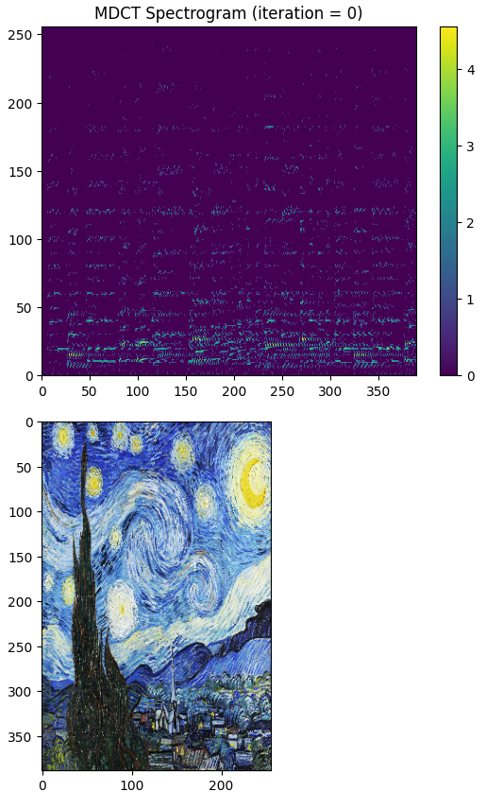
Style transfer
We import another picture, keep the red signal in the picture and discard the blue and green signal. Then, we reconstruct the spectrum to make its artstyle close to the picture.
Briefly talk in our code here, we loads the base image (MDCT spectrogram of the input music) and a style reference image fetched from a URL.

Slide 20
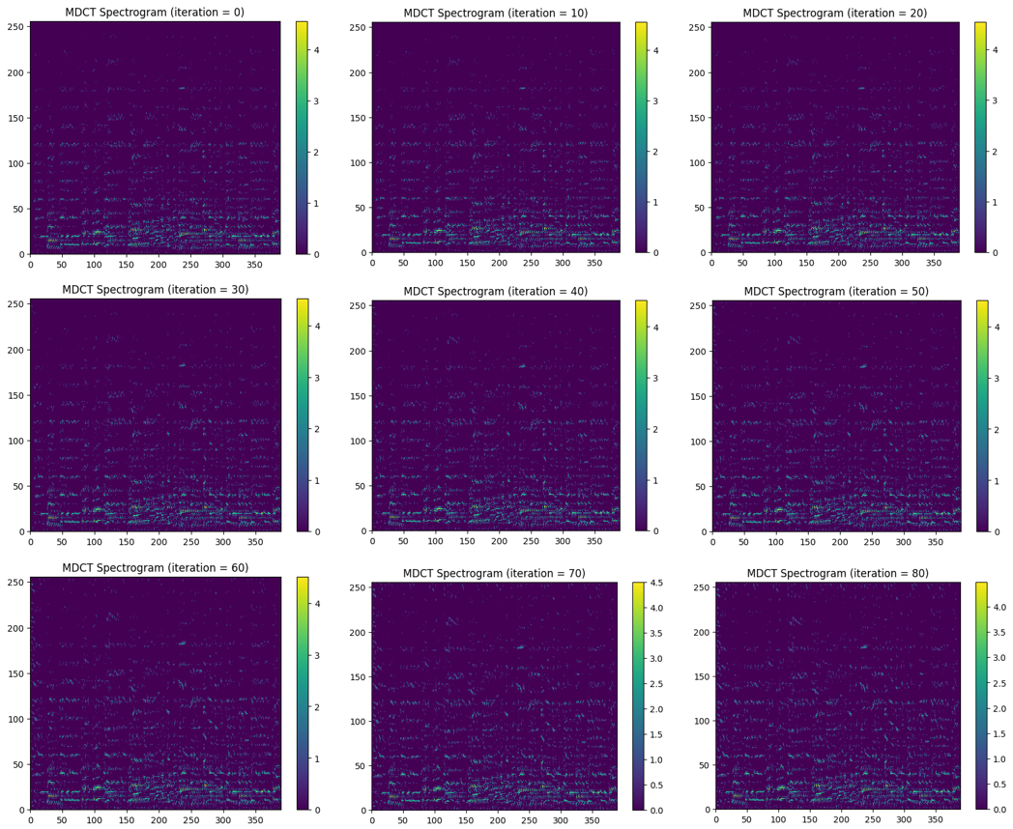
Convolutional Neural Network (CNN)
We use the Convolutional Neural Network to reconstruct the spectrum.
Which include many parts that we will detailed explain in code:
Loss Components
VGG19 Model
Loss and Gradient Computation
Training Parameters
Iterative Training
*The picture is the Spec of our code which the iteration from 0~80

Slide 21
Method’s Math

Slide 22
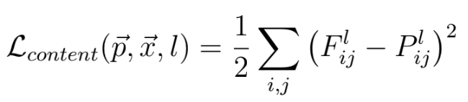
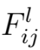
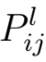
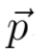
Content Reconstruction:
1. Feature Representation:
For each layer 𝑙 the CNN, the feature representation 𝐹𝑙 is a matrix of size 𝑁𝑙× 𝑀𝑙, where 𝑁𝑙 is the number of distinct filters in layer 𝑙 and 𝑀𝑙 is the height times the width of the feature map.
2. Content Loss:
The content loss for a layer 𝑙 is defined as:
is the activation of the i-th filter at position j in layer 𝑙.
is the corresponding activation for the original image

Slide 23
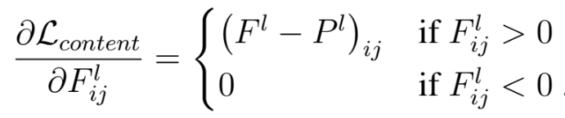
Content Reconstruction:
3. Gradient with Respect to Activation:
The derivative of this loss with respect to the activations in layer 𝑙 is:
This gradient is used for back-propagation during optimization.

Slide 24
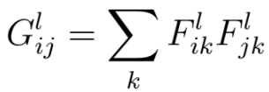
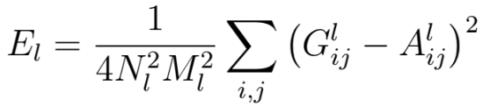
Style Reconstruction:
Gram Matrix:
For each layer 𝑙 the style representation involves computing the Gram matrix G𝑙, given by:
Style loss:
The style loss E𝑙​ for a layer 𝑙 is defined as:
A𝑙(ij) is the corresponding element of the Gram matrix for the original image

Slide 25
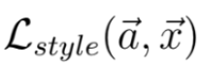
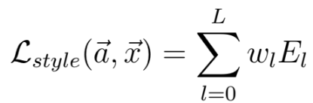
Style Reconstruction:
3. Total Style Loss:
The total style loss is a weighted sum of individual layer contributions:
The weights 𝔀𝑙 represent the contribution of each layer to the total loss.

Slide 26
Joint Content-Style Reconstruction:
Total Loss:
The total loss for joint content-style reconstruction is defined as:
𝛂 and 𝛃 are weighting factors for content and style reconstruction
Optimization:
The optimization involves minimizing this total loss using gradient descent to generate an image that combines content and style.

Slide 27
Generate_music_from
MusicGen_kagglemodels

Slide 28
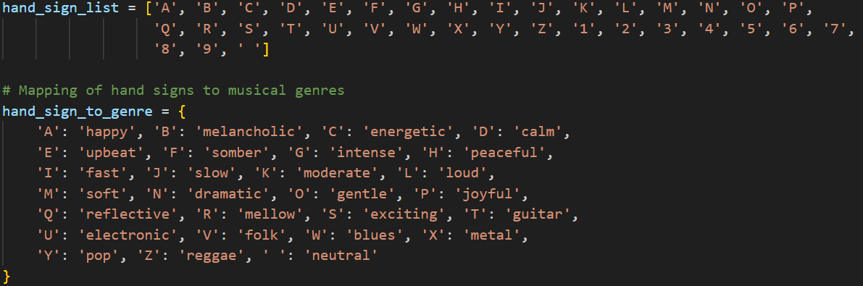

Slide 29
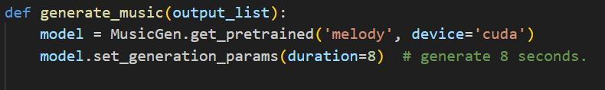
The second line loads a pre-trained MusicGen model using the get_pretrained method.
The third line sets the duration of the generated audio to 8 seconds using the set_generation_params method of the MusicGen model.

Slide 30
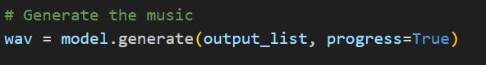
This line generates music based on the descriptions in output_list
This loop iterates over each generated audio sample in wav and saves it to a file

Slide 31

Combine hand gesture recognition and music generation

Slide 32
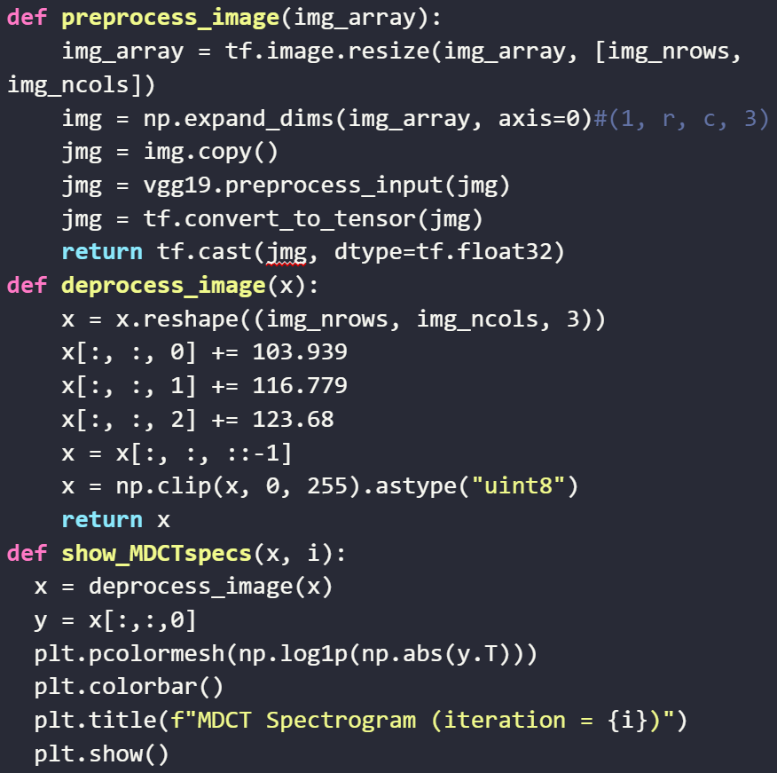
Image preprocessing / deprocessing utilities
1. preprocess_image Function:
To preprocess image arrays into suitable tensor formats.
2. deprocess_image Function:
To convert tensors back into valid image formats.
3. show_MDCTspecs Function:
To display the spectrogram of Modified Discrete Cosine Transform (MDCT).

Slide 33
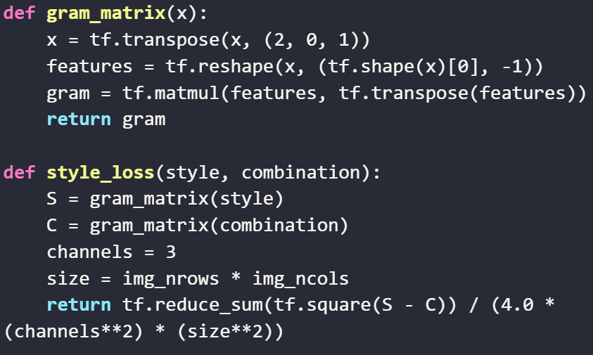
Style transfer loss utilities
These functions are part of a neural style transfer algorithm:
1. gram_matrix Function:
To compute the Gram matrix of a tensor.
2. style_loss Function:
To calculate the style loss.

Slide 34
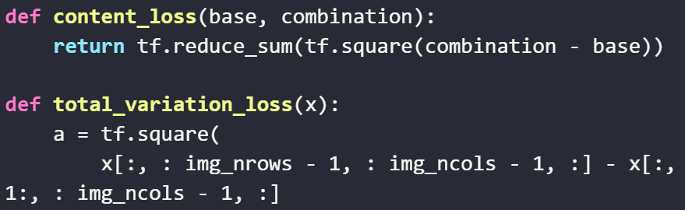
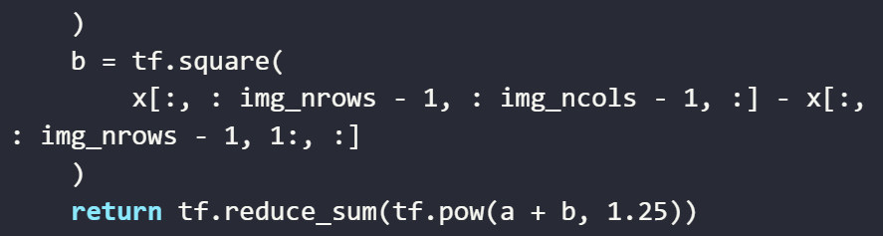
Style transfer loss utilities
3. content_loss Function:
To compute the content loss.
4. total_variation_loss Function:
To encourage spatial smoothness in the generated image.

Slide 35
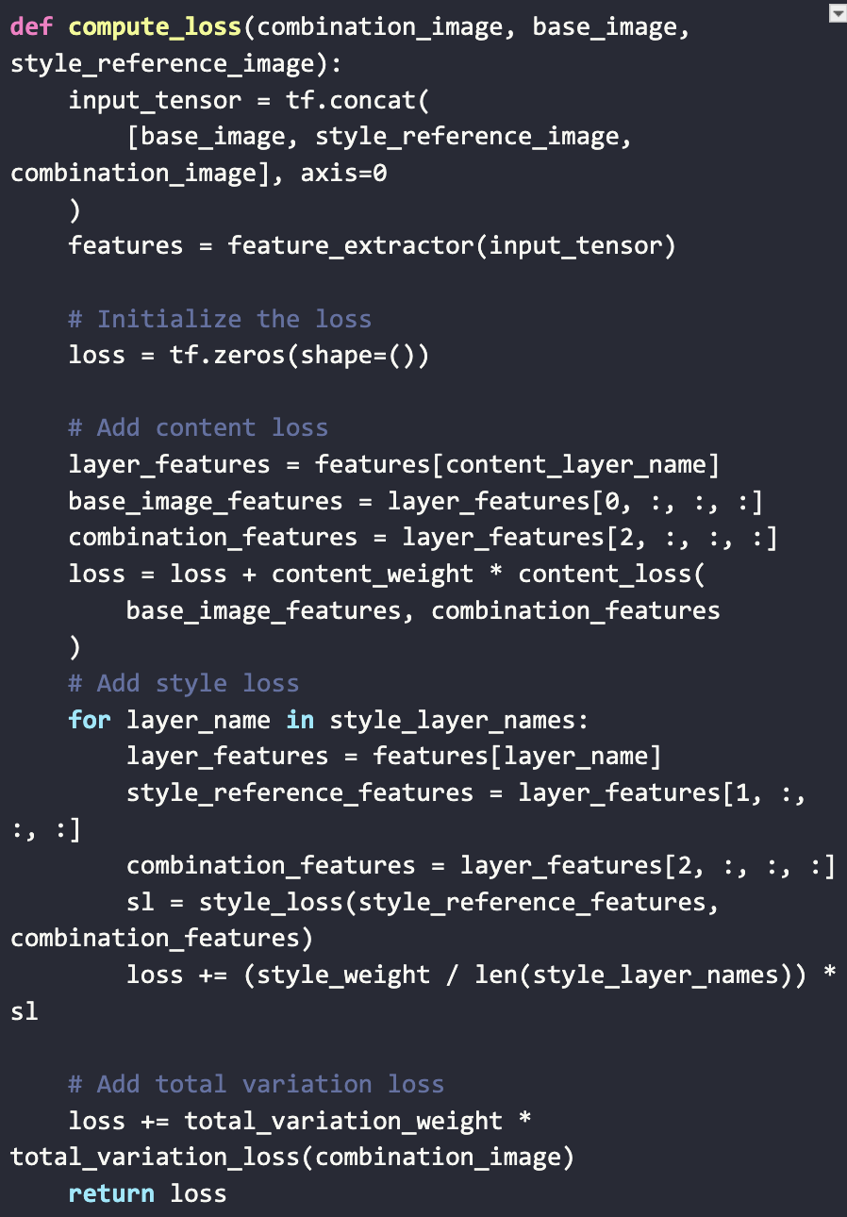
This compute_loss function is integral to the neural style transfer process. It calculates the total loss, which is a combination of content loss, style loss, and total variation loss:

Slide 36
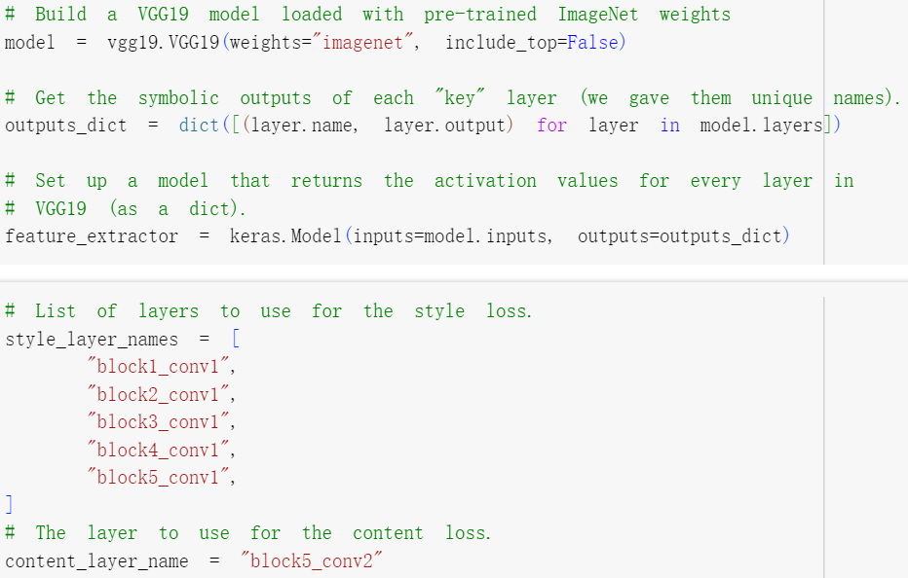
VGG19 Model
A pre-trained VGG19 model is used for feature extraction. Specific layers are selected for style loss, and a content layer is identified for content loss.

Slide 37
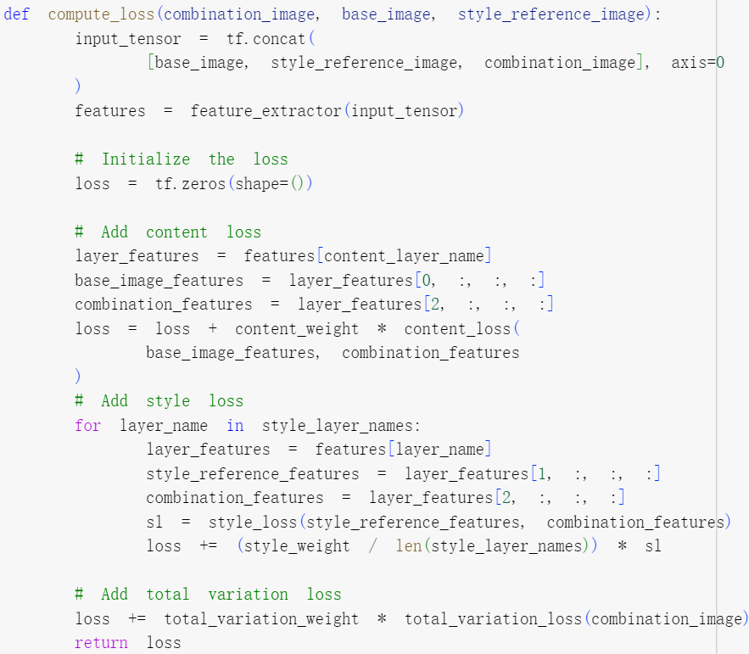
Loss and Gradient Computation
Loss Computation:
Calculates the total loss for neural style transfer by combining content loss, style loss, and total variation loss.
It measures the deviation of features in the generated image from the content of the original image and the difference in style between the generated image and a style reference image.

Slide 38
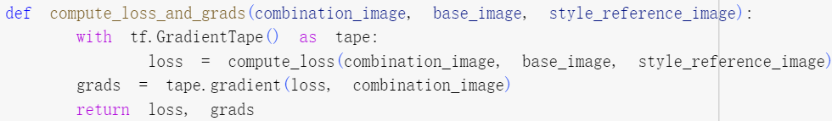
Loss and Gradient Computation
Compute_loss_and_grads:
It is defined for efficient computation of both loss and gradients using TensorFlow's GradientTape.

Slide 39
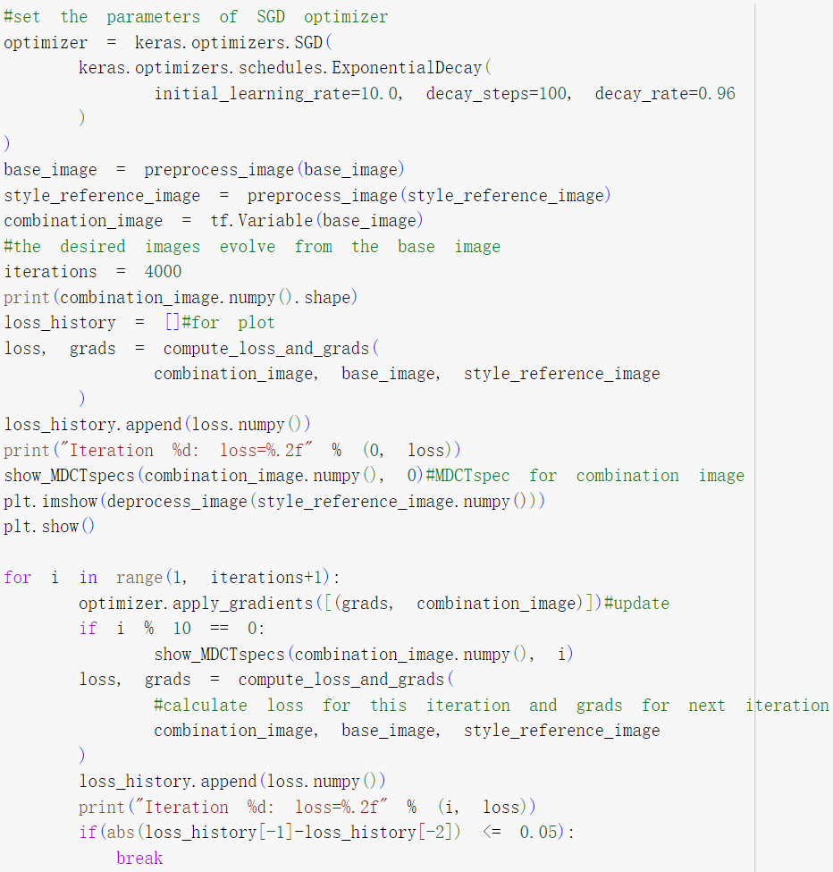
Training Process
Training Parameters:
Stochastic Gradient Descent (SGD) optimizer is configured with an initial learning rate, decay steps, and decay rate.
Iterative Training:
Model is trained iteratively, updating the combination image (styled music) using computed gradients. MDCT spectrograms are visualized at regular intervals.

Slide 40
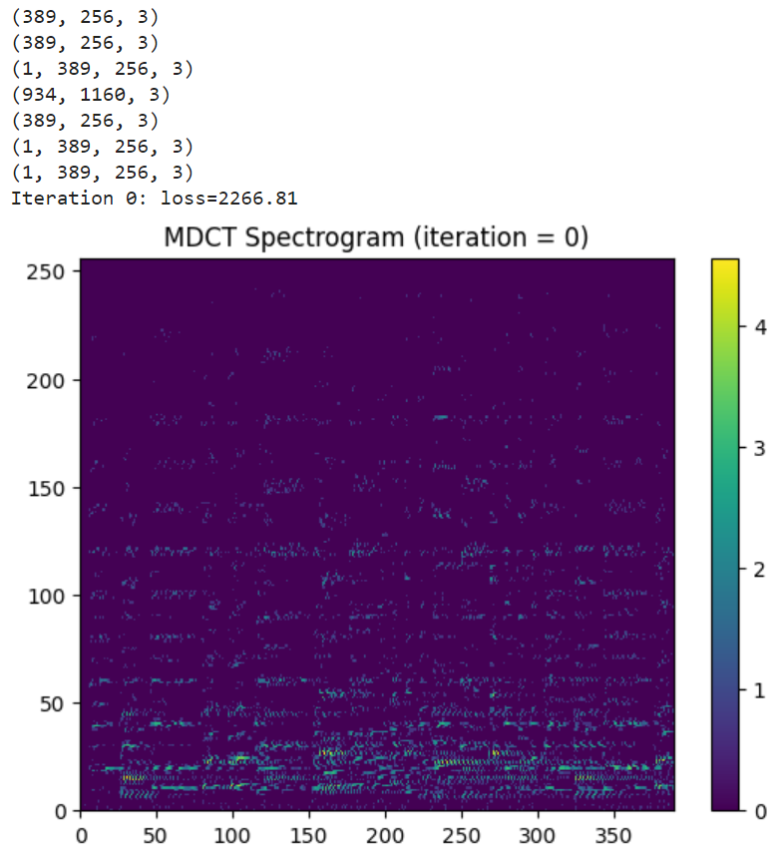
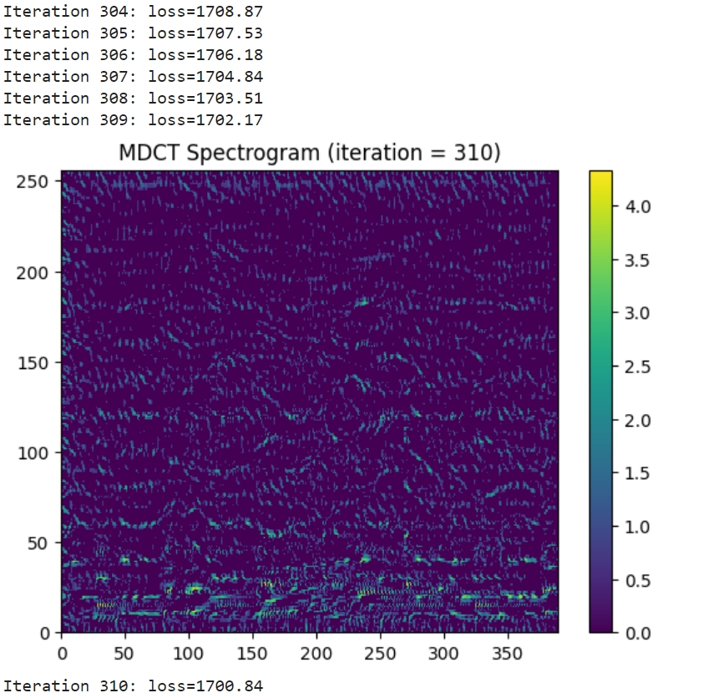
Result: Original MDCT Spectrogram V.S. Trained

Slide 41
Results and Conclusion

Slide 42
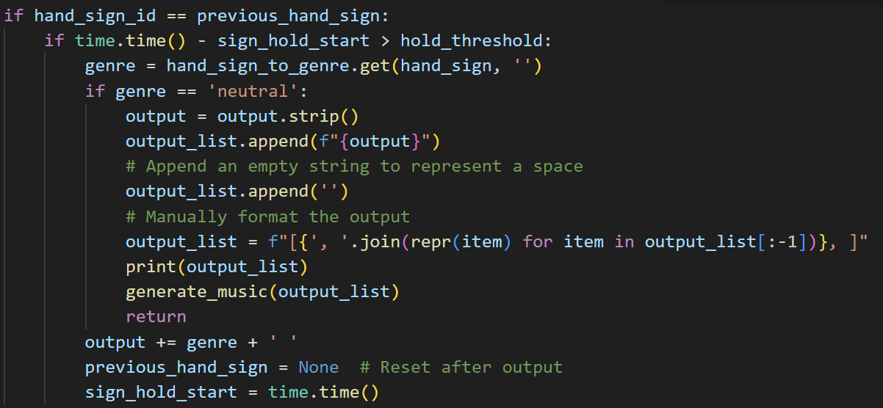

Result: Music Generated by Different Gestures (8s)
calm electronic(DU): fast happy(IA):
intense dramatic guitar(GNT): somber gentle metal(FOX):
happy energetic fast guitar(ACIT):

Slide 43



Slide 44



Slide 45



Slide 46


Conclusion
This time, we combined gesture recognition and music generation models into a new application. We encountered many issues during the implementation, mainly due to version incompatibilities. These challenges led us to learn new methods, such as creating virtual environments to resolve these issues.In this final project we all learn a lots, include addressing version incompatibility issues , learning new method, and making our idea to code.

